Slide 1
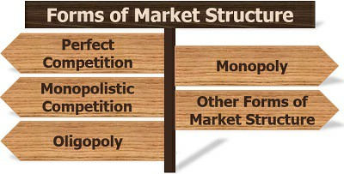
FORMS OF MARKET

Slide 2
MARKET
A medium by which buyers and sellers come in contact with each other and buy and sell goods and services.

Slide 3
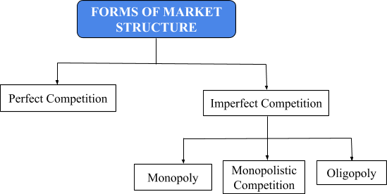
FORMS OF MARKET

Slide 4
Perfect Competition
It is a market in which there are large number of buyers and sellers dealing with homogeneous products.

Slide 5
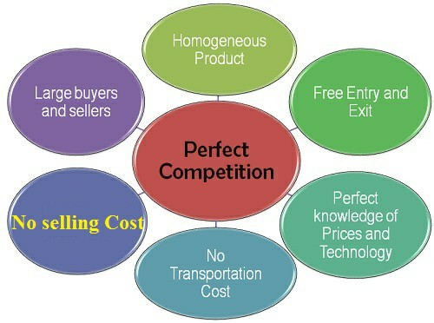

Slide 6
Large number of buyers and sellers
There are large number of buyers and sellers.
Implications:
Each ﬁrm contributes a small quantity of market supply. So, it cannot influence price by changing its supply. So, ﬁrm is price taker.
A single buyer cannot influence market price by changing his demand.

Slide 7
Homogeneous Products
All the sellers sell identical products. There is no product differentiation.
Implication:
As products are identical, no seller can charge a price which is higher than the market price.
There is uniform price in the market.

Slide 8
Freedom of Entry and Exit
There is no barrier to entry and exit. New ﬁrms can enter in to market and old ﬁrms can exit.
Implications:
The ﬁrm earns only normal proﬁt in the long run.
If there is abnormal proﬁt, new ﬁrms will enter the market. Supply will increase. Price will fall. Revenue will fall and abnormal proﬁt will disappear.
If there is loss, some ﬁrms will exit. Supply will fall. Price will increase. Revenue will increase. Loss will disappear.

Slide 9
Perfect knowledge of prices and technology
Buyers and sellers have perfect knowledge of prices and technology.
Implication
Buyers and sellers are aware of market price. So, no ﬁrm can charge a price which is higher than the market price.
Firms are aware of technology. So, all ﬁrms will use the best available technology. There will not be any difference in their production cost.

Slide 10
FIRM IS PRICE TAKER
In a perfectly competitive market, price is determined by the forces of market demand and supply.
AR and MR are equal because the ﬁrm can sell any quantity at the market rate.
AR curve, MR curve, Price line and demand curve are one and the same and it is parallel to X axis.

Slide 11
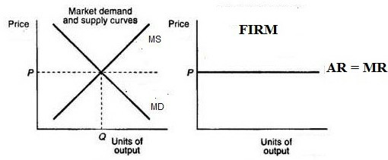

Slide 12
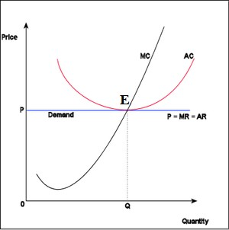
Normal Proﬁt under Perfect Competition

Slide 13
In the above diagram, at point E ﬁrm is in equilibrium because at the point MC and MR are equal.
At the same point AR and AC are also equal. So, ﬁrm earns only normal proﬁt

Slide 14
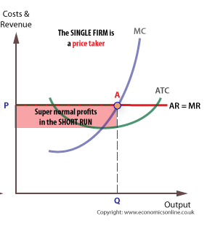
Firm earns abnormal proﬁt

Slide 15
In the above diagram, at point A ﬁrm is in equilibrium because at the point MC and MR are equal.
At the that point AR is greater than AC. So, ﬁrm earns only abnormal proﬁt.
New ﬁrms will be attracted. This will lead to increase in supply. Fall in price and reduction in revenue. Abnormal proﬁt will disappear in the long run.

Slide 16
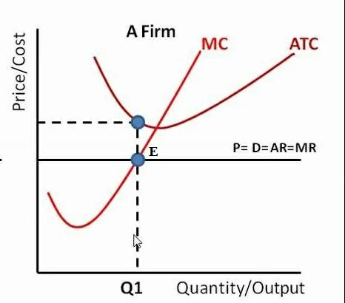
Firm incurs loss in Perfect Competition

Slide 17
In the above diagram, at point E ﬁrm is in equilibrium because at the point MC and MR are equal.
At the that point AR is less than AC. So, ﬁrm incurs loss.
Some ﬁrms will exit. This will lead to decrease in supply. Rise in price and revenue. Loss will disappear in the long run.

